Slide 1

HSE-Perm, UDC 09.03.04, Faculty of Economics, management and business Informatics, Department of information technology in business
Ethical Facebook
The work was performed by a 2nd year student of ПИ-18-2 group, faculty of economics, management and business informatics
Chepokov E. S.
Perm, 2019

Slide 2

Outline
About Facebook
Conditions of work
Fake news
Scandals
Conclusion
Perm, 2019
Chepokov Elizar Sergeevich «Ethics on Facebook»
In title

Slide 3

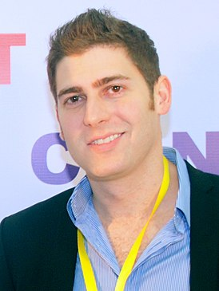
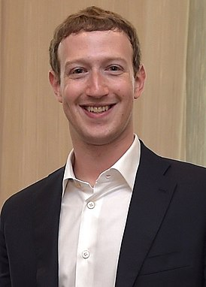

About Facebook
Launched: February 4, 2004
Number of users: 2.3 billion
About Facebook
Ethical Facebook
Unethical Facebook
Conclusion
Picture 1: Eduardo Saverin
Picture 2: Mark Zuckerberg
Perm, 2019
Chepokov Elizar Sergeevich «Ethics on Facebook»
In title

Slide 4
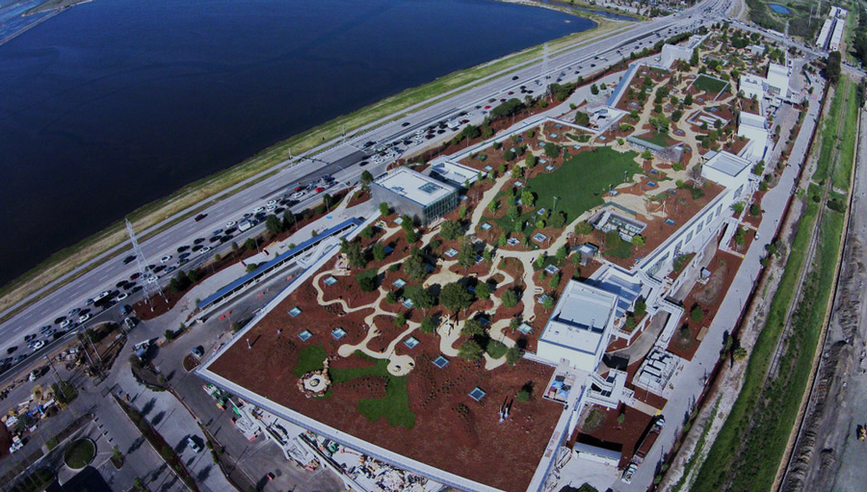
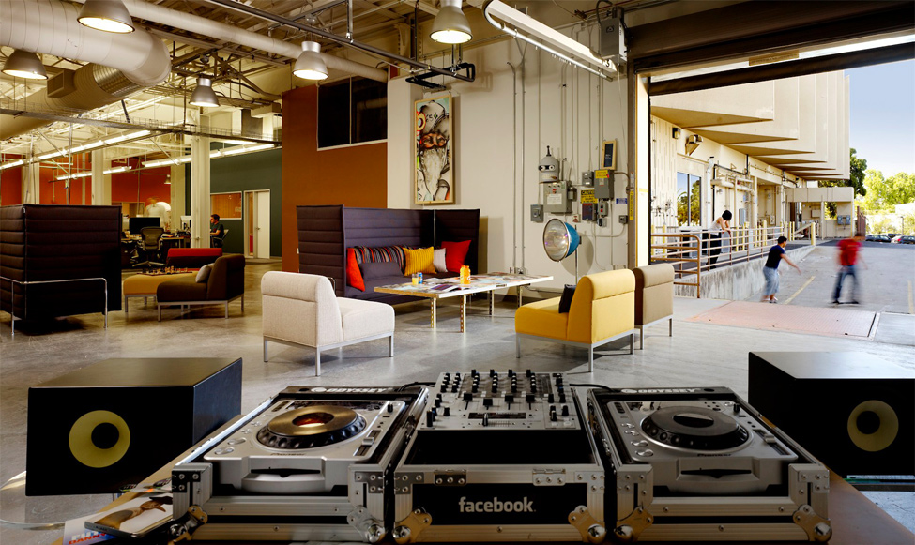
Conditions of work
Salary: $140,000 a year
Open space
Free food
About Facebook
Ethical Facebook
Unethical Facebook
Conclusion
Picture 3: Workspace
Perm, 2019
Chepokov Elizar Sergeevich «Ethics on Facebook»
In title

Slide 5

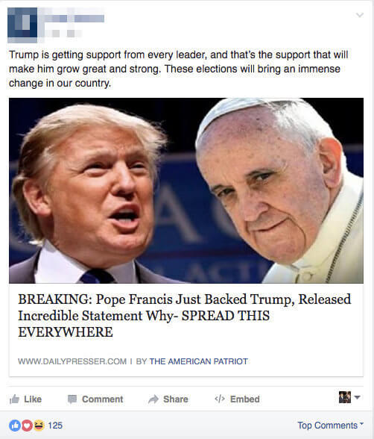
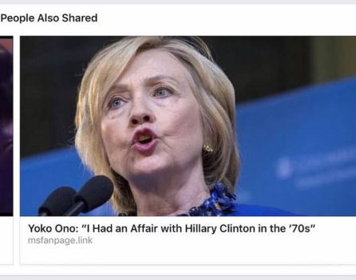
Fake news
About Facebook
Ethical Facebook
Unethical Facebook
Conclusion
Picture 4: Hillary Clinton in proposed news
Picture 5: Falsification about Trump
Perm, 2019
Chepokov Elizar Sergeevich «Ethics on Facebook»
In title

Slide 6
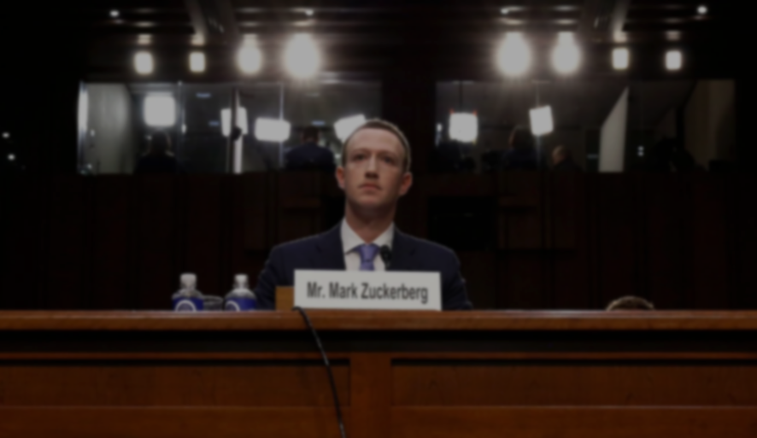
Scandals
About Facebook
Ethical Facebook
Unethical Facebook
Conclusion
«2.2 billion users — control it has wielded with little transparency or outside oversight»
Perm, 2019
Chepokov Elizar Sergeevich «Ethics on Facebook»
In title

Slide 7
Conclusion
The ethical and unethical sides of facebook have been identified
Over the past 4 years Facebook has been caught in more than 14 scandals
About Facebook
Ethical Facebook
Unethical Facebook
Conclusion
Perm, 2019
Chepokov Elizar Sergeevich «Ethics on Facebook»
In title

Slide 8
References
"The Mystery of Hillary's Missing Millions". Forbes. Retrieved August 11, 2017
The New York Times
Perm, 2019
Chepokov Elizar Sergeevich «Ethics on Facebook»
In title

Slide 9
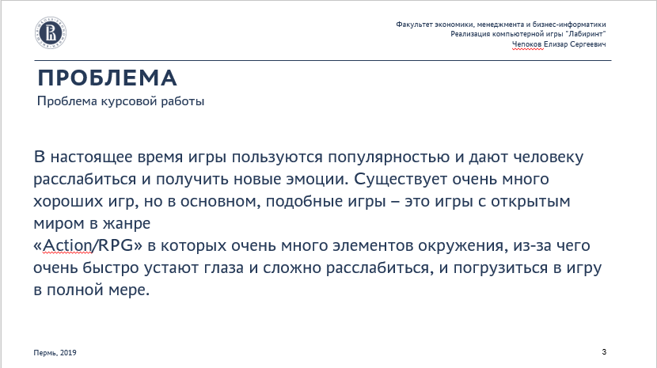
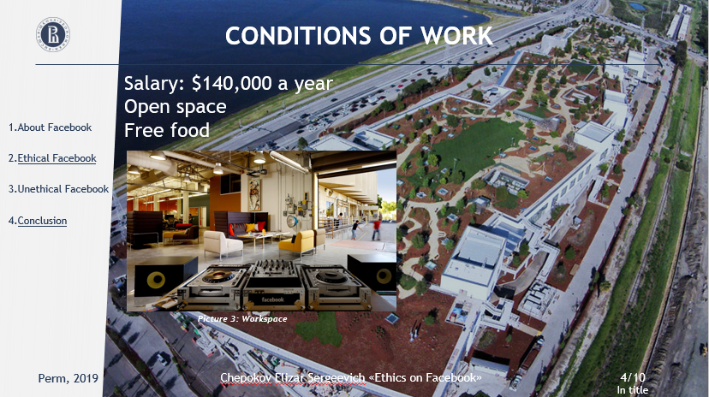
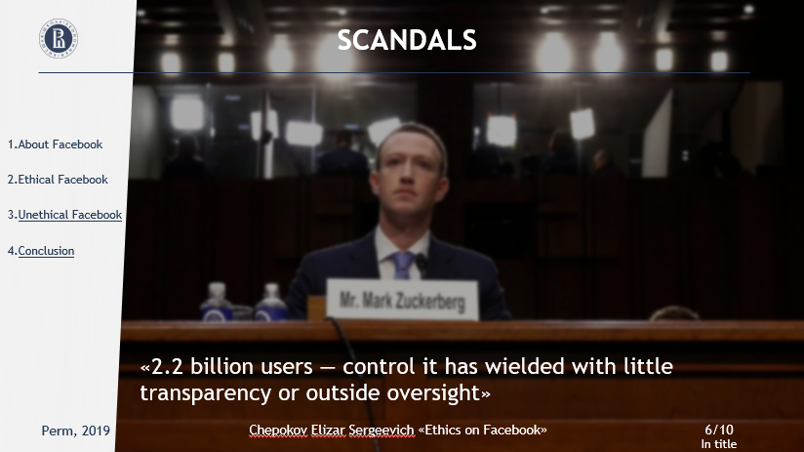
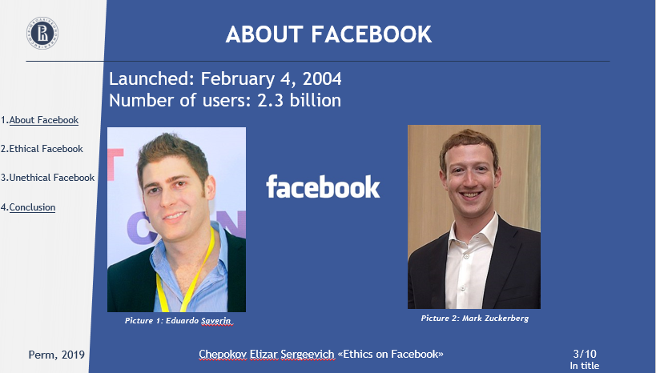
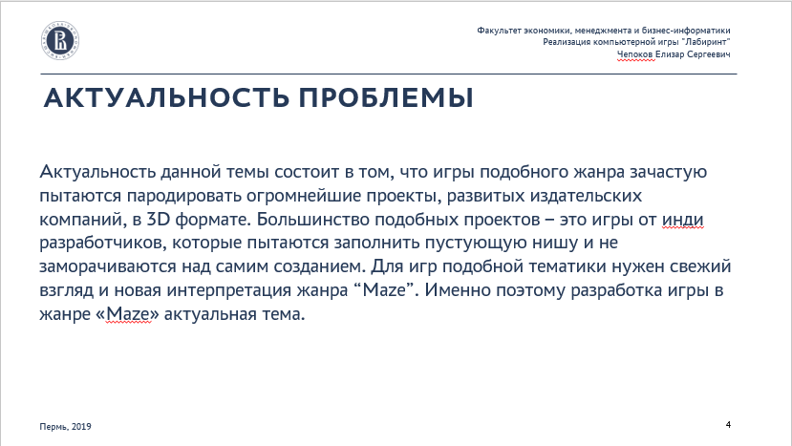
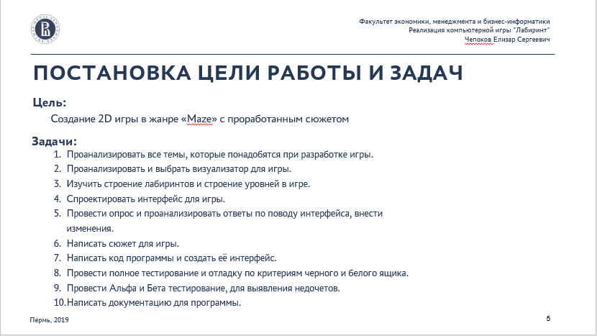
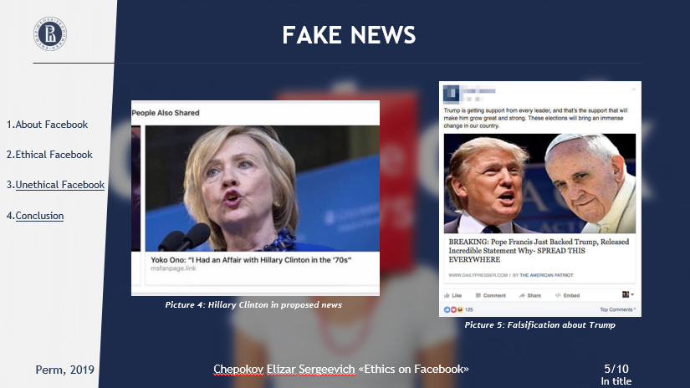

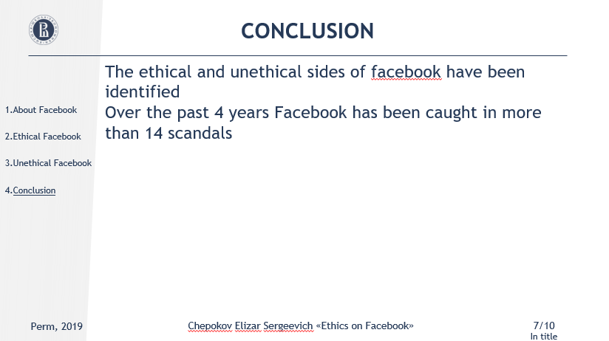
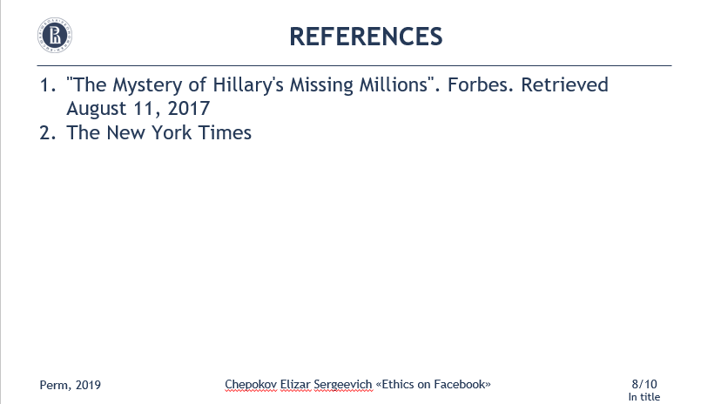

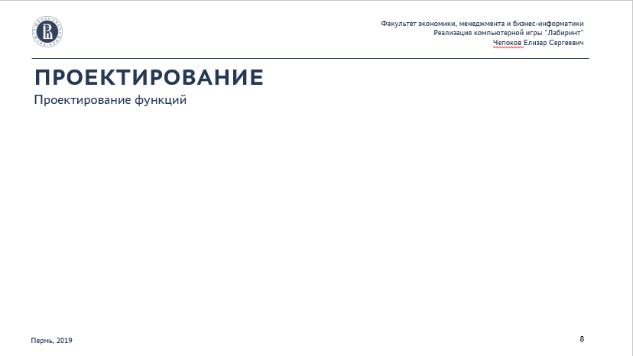
CONTENT LIST
3
4
5
6
7
8

Slide 10
THANK YOU FOR YOUR ATTENTION
I AM GLAD TO ANSWER YOUR QUESTIONS
Autor: Chepokov E. S.
Phone number: +7 (951) 959 4666
E-mail: eschepokov@edu.hse.ru

